Slide 1
JavaScript
Introduce By AJ

Slide 2
Regular Expression
1) Using literal syntax.
2) When you need to dynamically construct the regular expression, via the RegExp() constructor.
The literal syntax looks something like:
var RegularExpression = /pattern/
while the RegExp() constructor method looks like

Slide 3
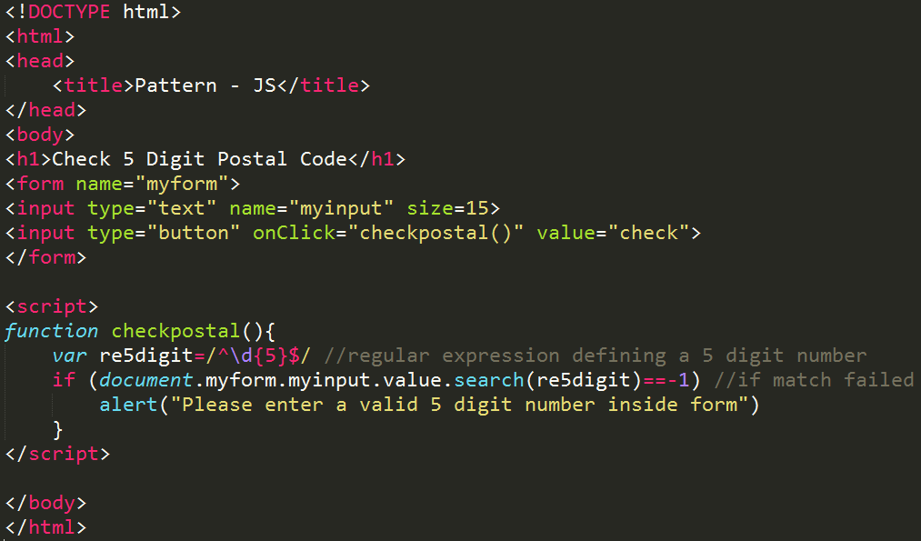

Slide 4
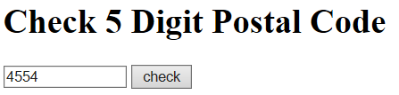
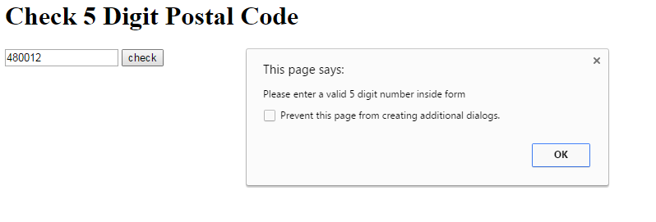

Slide 5
Regular Expression
\d : Match Digit Between 0-9.
{5} : Match Exactly five digit.
^ : Denote Start of String
/^Good/
$ : Denote End of String
/art$/

Slide 6
Regular Expression
Categories of Pattern Matching Characters
Pattern-matching characters can be grouped into various categories, which will be explained in detail later. By understanding these characters, you understand the language needed to create a regular expression pattern. The categories are:
Position matching- You wish to match a substring that occurs at a specific location within the larger string. For example, a substring that occurs at the very beginning or end of string.
Special literal character matching- All alphabetic and numeric characters by default match themselves literally in regular expressions. However, if you wish to match say a newline in Regular Expressions, a special syntax is needed, specifically, a backslash (\) followed by a designated character. For example, to match a newline, the syntax "\n" is used, while "\r" matches a carriage return.
Character classes matching- Individual characters can be combined into character classes to form more complex matches, by placing them in designated containers such as a square bracket. For example, /[abc]/ matches "a", "b", or "c", while /[a-zA-Z0-9]/ matches all alphanumeric characters.
Repetition matching- You wish to match character(s) that occurs in certain repetition. For example, to match "555", the easy way is to use /5{3}/
Alternation and grouping matching- You wish to group characters to be considered as a single entity or add an "OR" logic to your pattern matching.
Back reference matching- You wish to refer back to a subexpression in the same regular expression to perform matches where one match is based on the result of an earlier match.

Slide 7
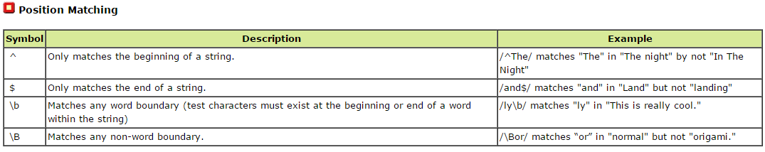
Regular Expression

Slide 8
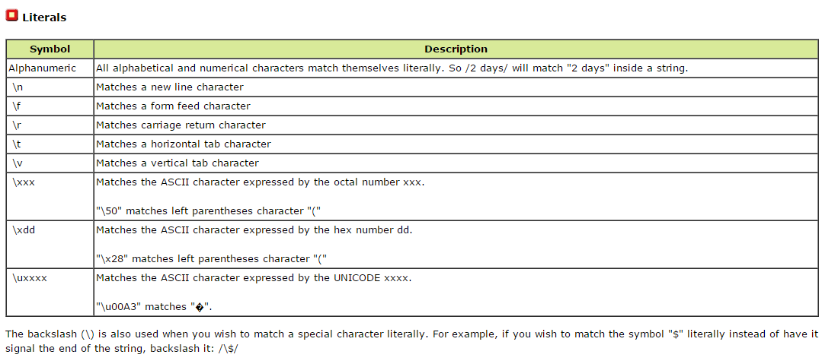
Regular Expression

Slide 9
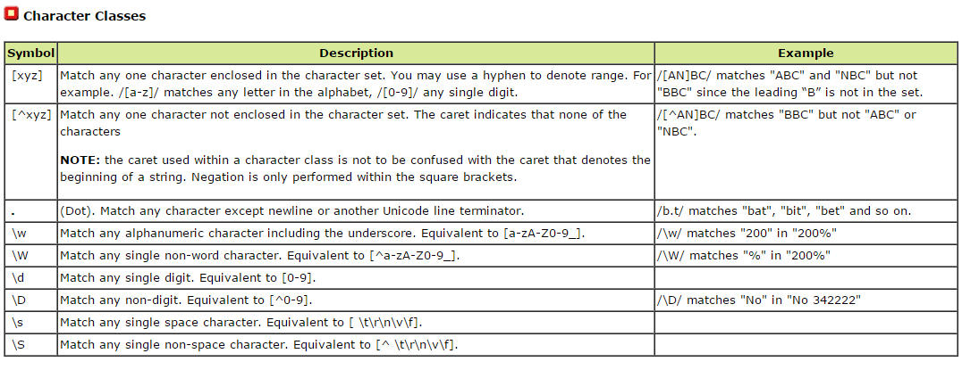
Regular Expression

Slide 10
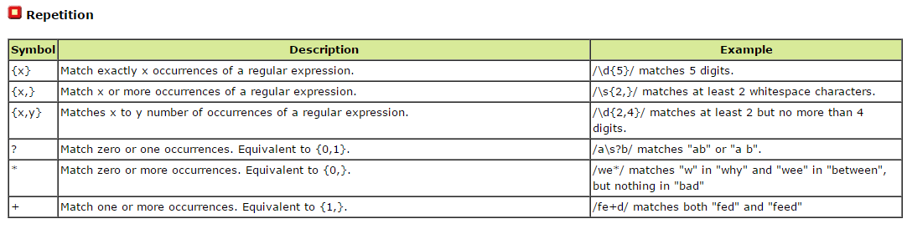
Regular Expression

Slide 11
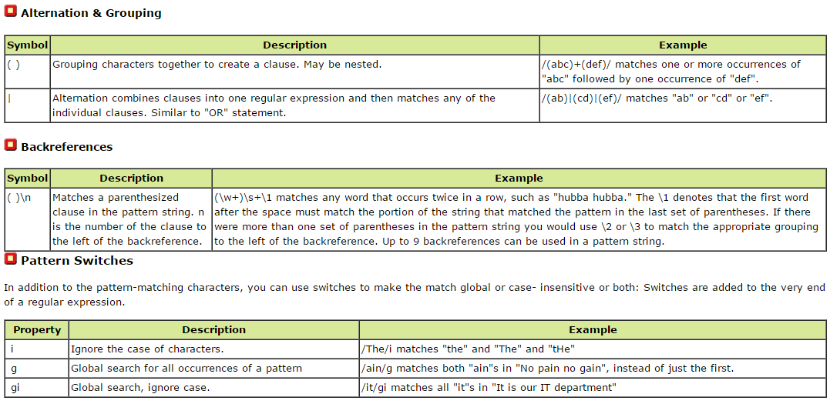
Regular Expression

Slide 12
Regular Expression
String and Regular Expression methods
The String object has four methods that take regular expressions as arguments. These are your workhorse methods that allow you to match, search, and replace a string using the flexibility of regular expressions:
String Methods Using Regular Expressions

Slide 13
Regular Expression
Method | Description
match( regular expression ) | Executes a search for a match within a string based on a regular expression. It returns an array of information or null if no match are found.Note: Also updates the $1…$9 properties in the RegExp object.
replace( regular expression, replacement text ) | Searches and replaces the regular expression portion (match) with the replaced text instead.Note: Also supports the replacement of regular expression with the specified RegExp $1…$9 properties.
split ( string literal or regular expression ) | Breaks up a string into an array of substrings based on a regular expression or fixed string.
search( regular expression ) | Tests for a match in a string. It returns the index of the match, or -1 if not found. Does NOT support global searches (ie: "g" flag not supported).

Slide 14
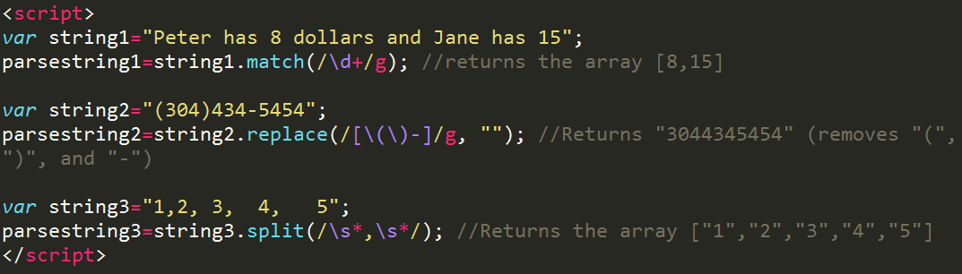
Regular Expression

Slide 15
Regular Expression
[] : Match any one character enclosed in the character set.
/[AN]BC/ matches "ABC" and "NBC" but not "BBC" since the leading “B” is not in the set.
() : Grouping characters together to create a clause. May be nested.
/(abc)+(def)/ matches one or more occurrences of "abc" followed by one occurrence of "def".

Slide 16
Regular Expression
RegExp methods and properties
You just saw several regular expression related string methods; in most situations, they are all you need for your string manipulation needs. However, true to the versatility of regular expressions, the Regular Expression (RegExp) object itself also supports two methods that mimic the functions of their string counterparts, the difference being these two methods take strings as parameters, while with String functions, they take a RegExp instead. The following describes the methods and properties of the regular expression object.

Slide 17
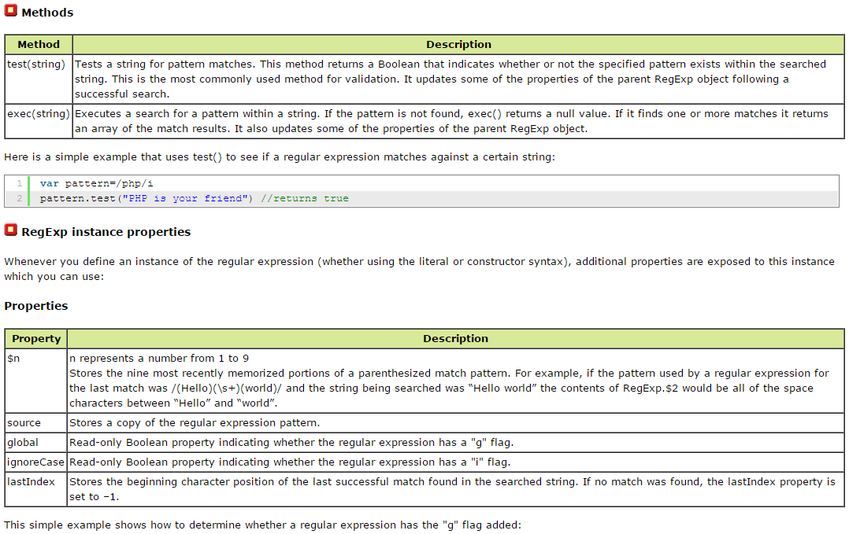
Regular Expression

Slide 18
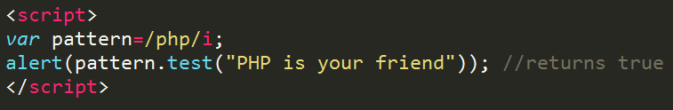
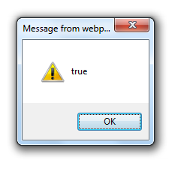
Regular Expression

Slide 19
Regular Expression Sample Usage
Valid Number
A valid number value should contain only an optional minus sign, followed by digits, followed by an optional dot (.) to signal decimals, and if it's present, additional digits. A regular expression to do that would look like this:
var anum=/(^-*\d+$)|(^-*\d+\.\d+$)/

Slide 20
Regular Expression Sample Usage
Valid Date Format
A valid short date should consist of a 2-digit month, date separator, 2-digit day, date separator, and a 4-digit year (e.g. 02/02/2000). It would be nice to allow the user to use any valid date separator character that your backend database supported such as slashes, dashes and periods. You want to be sure the user enters the same date separator character for all occurrences. The following function returns true or false depending on whether the user input matches this date format:
function checkdateformat(userinput){
var dateformat = /^\d{1,2}(\-|\/|\.)\d{1,2}\1\d{4}$/
return dateformat.test(userinput) //returns true or false depending on userinput
}

Slide 21
Regular Expression Sample Usage
Password
Password (UpperCase, LowerCase and Number)
^(?=.*\d)(?=.*[a-z])(?=.*[A-Z])(?!.*\s).*$
Password (UpperCase, LowerCase, Number/SpecialChar and min 8 Chars)
(?=^.{8,}$)((?=.*\d)|(?=.*\W+))(?![.\n])(?=.*[A-Z])(?=.*[a-z]).*$

Slide 22
Regular Expression Sample Usage
Password
Contain only three letters (no numbers or special characters)
<input type="text" name="country_code" pattern="[A-Za-z]{3}" title="Three letter country code">

Slide 23
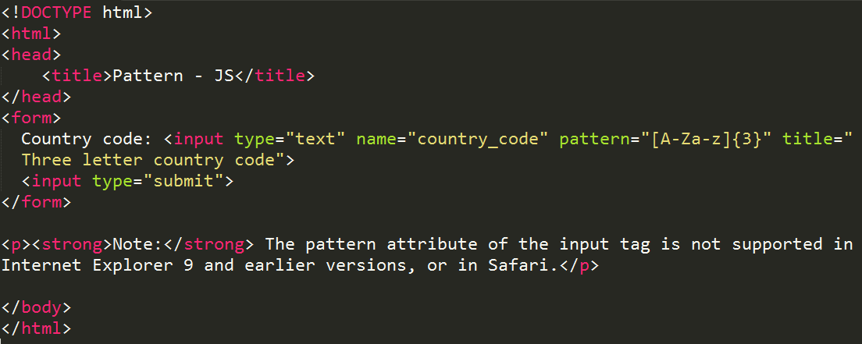
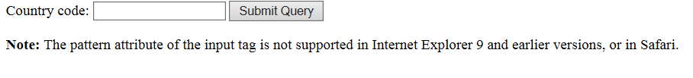
Regular Expression Sample Usage

Slide 24
Regular Expression Sample Usage
Password
Must contain 6 or more characters
Password: <input type="password" name="pw" pattern=".{6,}" title="Six or more characters">
contain 8 or more characters that are of at least one number, and one uppercase and lowercase letter.
Password: <input type="password" name="pw" pattern="(?=.*\d)(?=.*[a-z])(?=.*[A-Z]).{8,}"title="Must contain at least one number and one uppercase and lowercase letter, and at least 8 or more characters">

Slide 25
Regular Expression Sample Usage
Username with 2-20 chars
^[a-zA-Z][a-zA-Z0-9-_\.]{1,20}$ Username with 2-20 chars
^[a-zA-Z][a-zA-Z0-9-_\.]{1,20}$
Email
var email: /^[a-z0-9._%+-]+@[a-z0-9.-]+\.[a-z]{2,4}$/;
E-mail: <input type="email" name="email" pattern="[a-z0-9._%+-]+@[a-z0-9.-]+\.[a-z]{2,3}$">
Homepage: <input type="url" name="website" pattern="https?://.+" title="Include http://">

